Slide 1
Employee Data Analysis using Excel
STUDENT NAME:M.NARMADHA
REGISTER NO:22CO148
NAAN MUDHALVAN ID:asunm110122200222
DEPARTMENT:B.COM CORPORATE SECRETARY SHIP
COLLEGE:D.R.B.C.C.C.HINDU COLLEGE

Slide 2
PROJECT TITLE
Employee Performance Analysis using Excel

Slide 3


AGENDA
Problem Statement
Project Overview
End Users
Our Solution and Proposition
Dataset Description
Modelling Approach
Results and Discussion
Conclusion
3/21/2024 Annual Review

Slide 4

PROBLEM STATEMENT
*Data Collection: Gather data on employee performance metrics, including sales figures, project completion rates, attendance records, and customer feedback scores. Ensure the data is collected for each employee over a consistent time period.
*Data Organization: Import and organize the data into Excel, ensuring each metric is clearly labeled and each employee's data is accurately recorded. Use Excel features such as tables and named ranges for better data management.

Slide 5

PROJECT OVERVIEW
*Data Points: Identify the key performance indicators (KPIs) relevant to your analysis (e.g., sales numbers, project completion rates, attendance).
*Sources: Gather data from relevant sources (e.g., HR systems, sales reports, project management tools).
*Determine what aspects of performance you want to analyze (e.g., productivity, attendance, goal achievement).
*Set clear goals for what you aim to achieve with the analysis (e.g., improving performance, identifying top performers).

Slide 6

WHO ARE THE END USERS?
*Manager and supervisor
*Human resources
*Team leader
*Senior executive

Slide 7

OUR SOLUTION AND ITS VALUE PROPOSITION
*Data Collection: Excel allows for easy aggregation of performance data, including metrics like productivity, punctuality, quality of work, and goals achieved.
*Customizable Metrics: Create tailored performance metrics relevant to your organization’s needs.
*Data Analysis Tools: Utilize formulas, pivot tables, and charts to analyze performance trends, compare individuals, and identify areas for improvement.
*Visualization: Use Excel’s charting and graphing tools to visualize performance data for better insights.

Slide 8
Dataset Description
*Descriptive Statistics: Calculate averages, medians, and standard deviations for performance scores and other key metrics.
*Performance Trends: Create charts (e.g., bar charts, line graphs) to visualize trends over time or across departments.
*Comparative Analysis: Use pivot tables to compare performance across different departments or job titles.

Slide 9

THE "WOW" IN OUR SOLUTION
*Data collection
*Data Organization
*Analysis
*Visualization
*Performance tracking
*Data entry
3/21/2024 Annual Review
9

Slide 10
MODELLING
*Define Metrics: Determine what performance metrics you want to track, such as sales numbers, project completion rates, attendance, customer feedback, or specific KPIs relevant to your organization.
*Create a Data Table: 1 Columns: Include columns for Employee Name, ID, Department, and each performance metric you’ve identified.2 Rows: Each row will represent a different employee.
*Input Data: Enter the performance data into the table. You might want to include historical data for trend analysis.
10

Slide 11
RESULTS
*Organize Data: Enter the data into Excel. Typically, columns might include employee names, performance metrics, dates, and any other relevant criteria.
*Use Formulas:1 Averages: Use =AVERAGE(range) to find average performance.2 Totals: Use =SUM(range) to aggregate totals.3 Percentages: Use =(part/total)
*100 for percentage calculations.
11

Slide 12
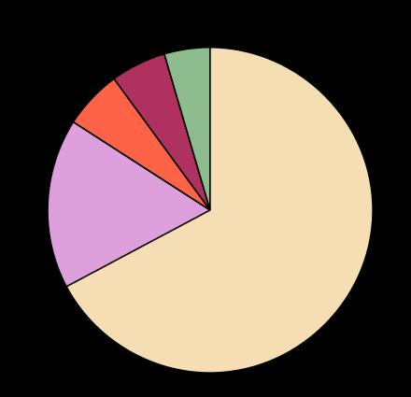
Results

Slide 13
conclusion
*Summary of Findings: Recap the main insights derived from the data. This could include overall performance trends, top performers, areas needing improvement, and any patterns or anomalies observed.
*Performance Metrics: Highlight specific metrics used in the analysis, such as productivity rates, quality of work, attendance, or goal achievement, and how these metrics relate to the performance outcomes.

